Slide 1

Novel approach to generating training data for twitter sentiment analysis Capstone Project Jack Sticklen, R&D Data Scientist

Slide 2
Agenda
Bio
Project Context
Define
Design
Deliver
Summary, conclusions and next steps
Appendix: list of supporting documents

Slide 3
Bio
Background firmly in engineering
Hold a Bachelor of Chemical and Biological Engineering
Experience in analysis and modelling of physical systems
Have built on analytical base with data exploration and modelling tools gained through course
This project is a break from traditional experience – diving right into Natural Language Processing

Slide 4
Agenda
Bio
Project Context
Define
Design
Deliver
Summary, conclusions and next steps
Appendix: list of supporting documents

Slide 5

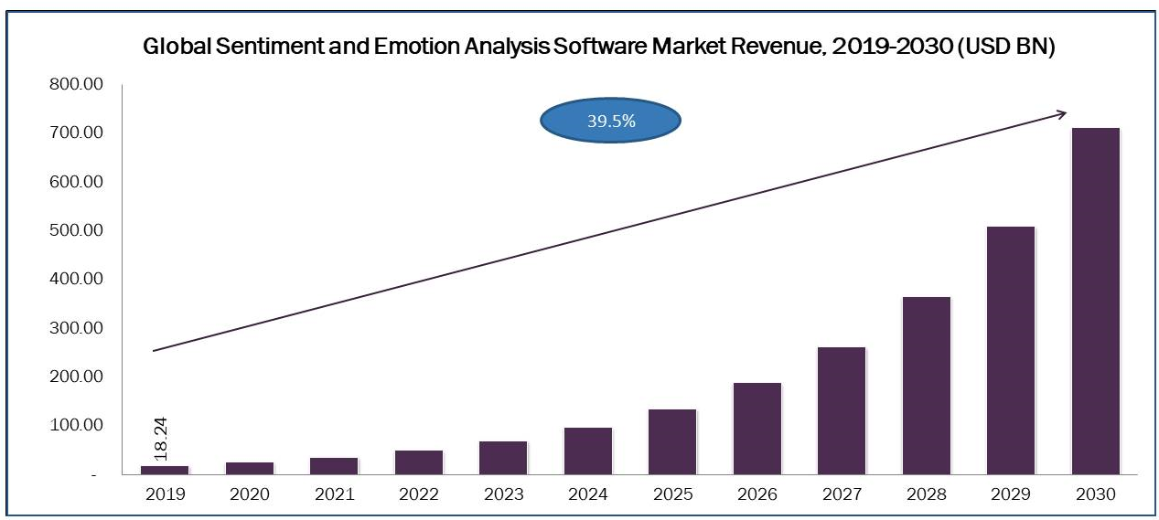
Project Context: Sentiment Analysis
In 2019 the sentiment analysis software market size was estimated at 18.24 Billion – to reach 710 Billion by 2030
Big Problem in sentiment analysis: what to use as training data?
Bad Training data = bad model

Slide 6

Project context Past work on Sentiment Analysis
First approach: use pre-labelled public data
A popular set is the Sentiment Labelled Sentences Data Set – a collection of manually labelled reviews from three different websites
UCI Machine Learning Repository: Sentiment Labelled Sentences Data Set

Slide 7
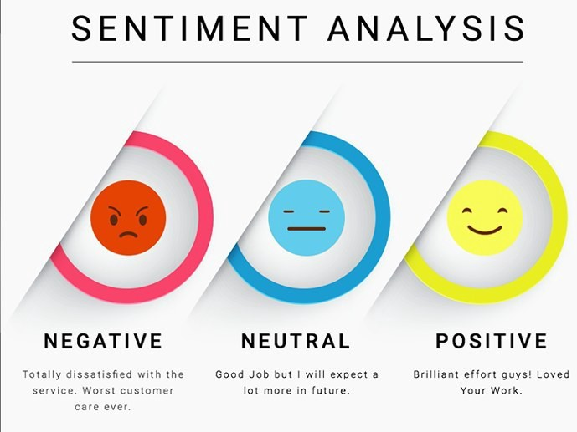
Project context Past work on Sentiment Analysis
Second approach: use lexicon and rule-based sentiment analysis tool
Such as VADER – optimised for social media
Only need to input tweet text – minimal pre-processing

Slide 8
Project context Past work on Sentiment Analysis
Novel approach: used by Ramteke et. al. to generate training set from dataset itself
Assigned training sentiment via a combination of two methods:
Hashtag grouping – where tweets with official campaign hashtags were assumed a sentiment
Used VADER to derive sentiment polarity scores, then assigned sentiment labels to very high or very low-scoring tweets
But they did not verify model performance against manually labelled data!

Slide 9
Agenda
Bio
Project Context
Define
Design
Deliver
Summary, conclusions and next steps
Appendix: list of supporting documents

Slide 10

Business Case
Who are our stakeholders?
Marketers and campaigners – need ways to measure sentiment
Organisation as a whole – reputation management
Core BUSINESS Question:
How do we improve the accuracy of sentiment metrics, without significant additional cost or inputs?

Slide 11
Business Case The Data Side
One way to resolve business question:
Develop a method for producing accurate training data WITHOUT requiring manual labelling or additional data
Core data question becomes:
How do we generate application-specific training targets using only the feature data?
And how do we verify the performance?

Slide 12
Business Case The Data Side
What kind of data will allow us to explore this question?
Need twitter tweet data on specific topic – in order to perform hashtag clustering
Dataset to have sentiment pre-labelled manually – needed for verification
Dataset needs to be large enough to ensure method produces enough training data

Slide 13

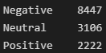
Business Case The Data Set
Enter: GOP Debate Dataset
Publicly available collection of 13 800+ tweets – from Kaggle
Tweets are related to the first 2016 Republican Presidential debate – based on the official hashtag usage #GOPDebate
Sentiment scores for each tweet have been manually labelled by volunteer contributors – potential weakness
https://www.kaggle.com/datasets/crowdflower/first-gop-debate-twitter-sentiment?resource=download&select=Sentiment.csv

Slide 14
Agenda
Bio
Project Context
Define
Design
Deliver
Summary, conclusions and next steps
Appendix: list of supporting documents

Slide 15
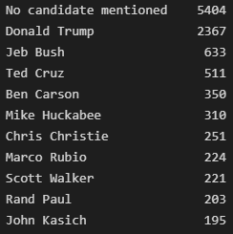
Design Data Exploration and visualisation
One basic Feature: TWEETS:
Hashtags are important for the training set:
Candidate mentions help us contextualise:
“@DanScavino: #GOPDebate w/ @realDonaldTrump delivered the highest ratings in the history of presidential debates. #Trump2016 Fox say thanks
#GOPDebate, #Trump2016

Slide 16
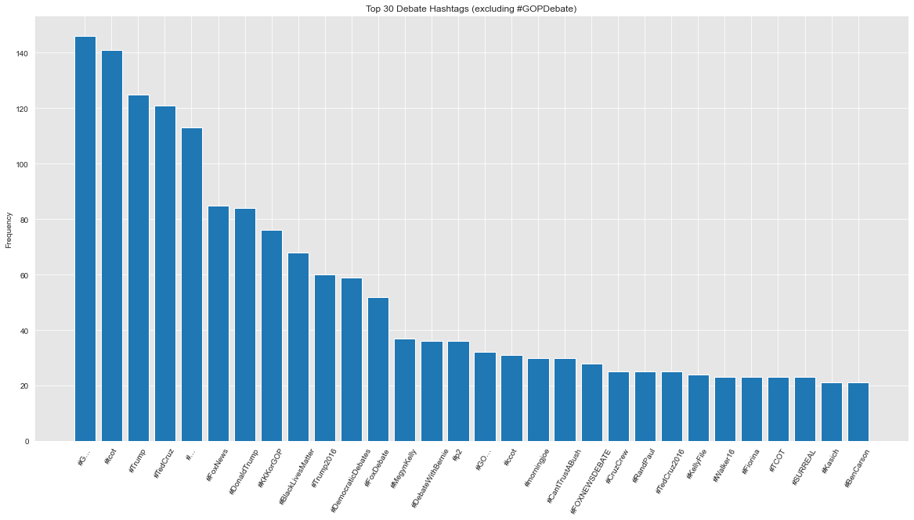
Design Data Exploration, analysis, and visualisation

Slide 17
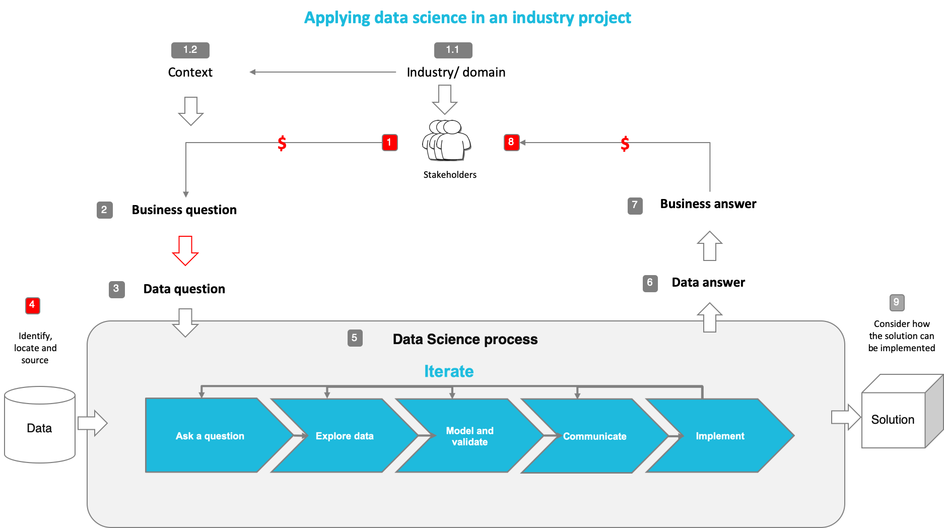
You may use this diagram or your simplified version with project relevant information

Slide 18
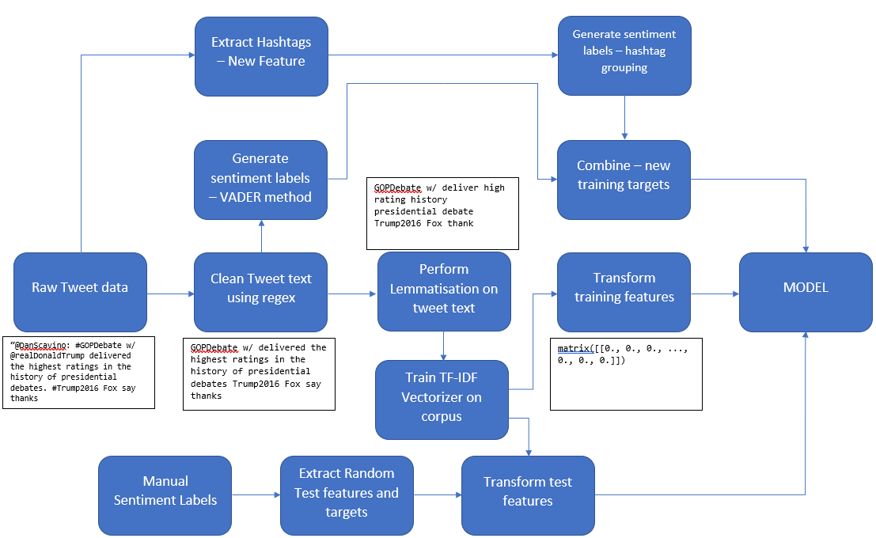
Feature Engineering

Slide 19
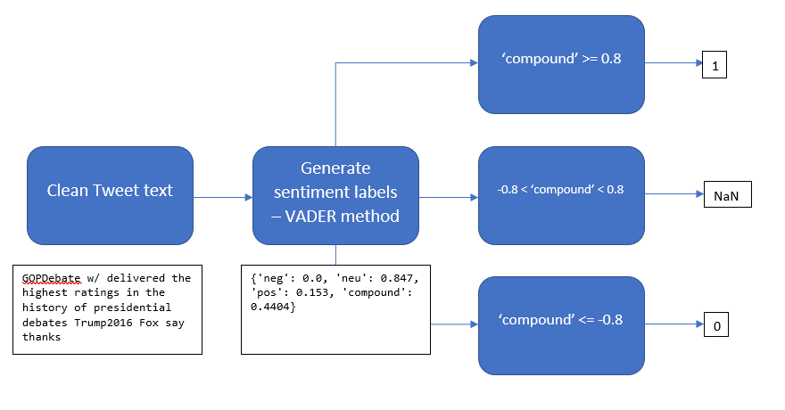
Feature Engineering

Slide 20
Agenda
Bio
Project Context
Define
Design
Deliver
Summary, conclusions and next steps
Appendix: list of supporting documents

Slide 21
Machine Models
Three models used - ensuring that model design does not impact evaluation
Support Vector Classification – Works well with clear separation between classes, and with high dimensional features (such as vectorized text)
Multinomial Naïve Bayes – Best with multiclass categorical features and binary target
Random Forest Classifier – Generally accurate and robust compared to other non-linear classifiers
Primary evaluation metrics: Accuracy then ROC AUC score

Slide 22
Machine Models Business Context
This is a R&D exercise – goal is to compare performance more broadly, thus three models.
To evaluate three sets of training data are used:
Novel method – as discussed and shown earlier
Pre-labelled external data – common practise, will employ the UCI review set from the literature
Pure VADER sentiment assignation – no additional machine learning model used, pure simple method
With such a broad evaluation, in-house data scientists can more easily dissect the value of the new training method
If successful, business has new way to easily and cheaply generate training data to improve accuracy of product performance measures

Slide 23
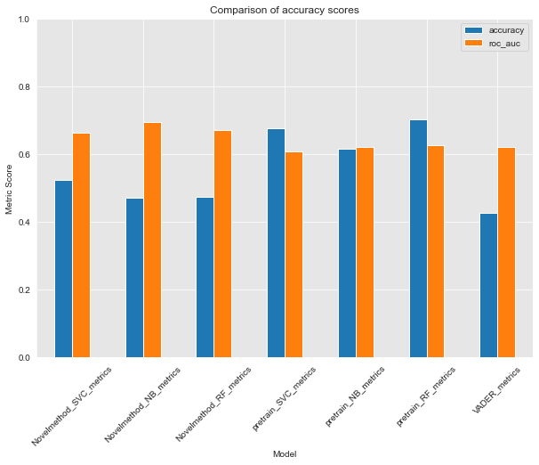
Results Accuracy Chart
Accuracy of externally-trained models are significantly higher than the novel method
ROC AUC for novel method is marginally higher, but not as important a metric as raw accuracy
Pure VADER sentiment assignation performs very poorly

Slide 24
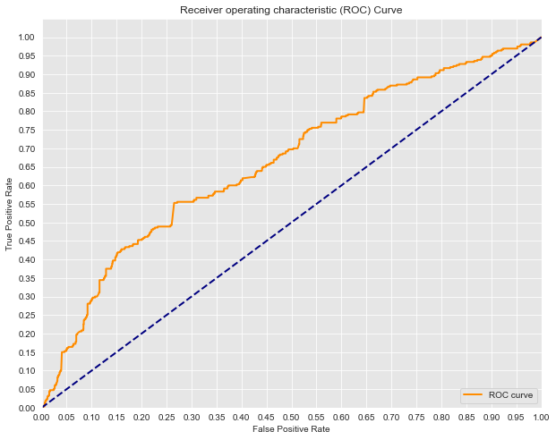
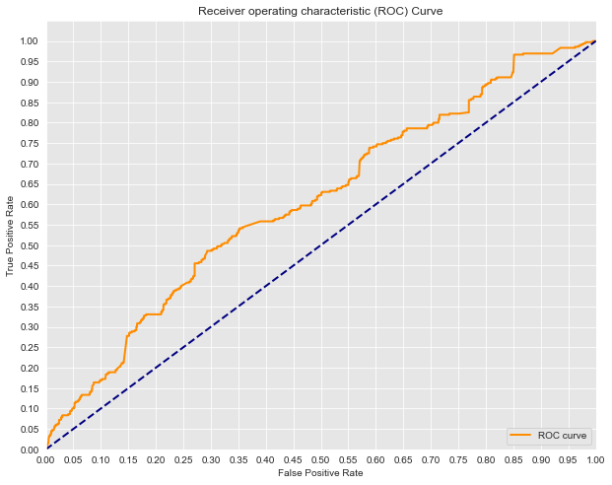
Results ROC Curves
Novel Method – SVC Model
Pre-labelled data Method – SVC Model

Slide 25
Agenda
Bio
Project Context
Define
Design
Deliver
Summary, conclusions and next steps
Appendix: list of supporting documents

Slide 26
Summary
What have we covered today?
The Problem: Need a way to automatically generate training labels – improve sentiment labelling accuracy
The Data: Topic-focussed tweet corpus – tweets during the 2016 GOP debates
The Solution: Use hashtag labelling and lexicon-based polarity scoring to create synthetic sentiment labels
The Result: Method performs badly compared to more traditional solutions

Slide 27
Conclusions and next steps
Primary lesson: the novel training method was less accurate on the test data across the board when compared to training models on pre-labelled data
May depend on the application in question – but generally can be concluded that this method is too unreliable for broader used.
Furthermore, pure VADER polarity score assignment performs the worst – model is designed for the existence of pos, neg, and NEUTRAL labels, which could explain problem
In future, further exploration of VADER would be warranted:
Generating training data without hashtags – only changing VADER score thresholds
Testing VADER in applications with three sentiment labels as above

Slide 28
Questions

Slide 29
Appendices

Slide 30
End of Presentation!

